Slide 1
Embedding Experiential Learning with Interactive Virtual Learning Environments
Susanne James, PhD
Barb Martin, EdD
March 16, 2017
S & T TLT Conference

Slide 2
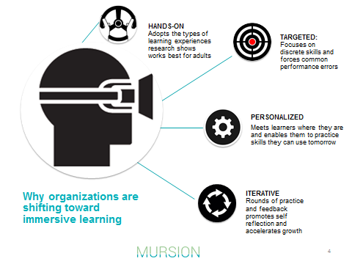
Why Experiential Learning?

Slide 3
Experiential Learning
Practice with no harm/risk to others (CPR-Recessi-Annie, cadaver)
Actively construct knowledge and apply in context
Immediate Feedback
Debrief process where critical feedback can be incorporated in future practice
Suspend session, regroup/discuss better options, restart session and practice new techniques
Avenue for self-reflection
Immersive
“Students are virtual and the teaching is real.”
Notes:
Wendy

Slide 4
Virtual Learning Environments
Brief History
Previously applied to health care, military, and law enforcement
Takes high risk practice into safe environment for repeated practice and skill mastery
Notes:
Barb

Slide 5
Other Applications of VLE
Education
Business Administration
Human Resources
Customer Service
Health Services
Psychology
Health Education
Notes:
barb

Slide 6
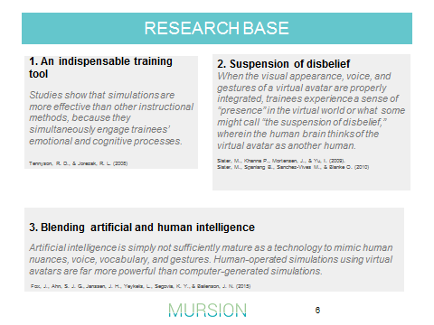
Research

Slide 7
SIUe TeachLive Simulation Lab
Notes:
susanne

Slide 8
Notes:
susanne

Slide 9
Notes:
susanne

Slide 10
Notes:
barb

Slide 11
Notes:
barb

Slide 12
Notes:
barb

Slide 13
Questions?
Let’s try it!

Slide 14
Contact Us:
Susanne James, sjames@siue.edu
Barbara Martin, barmart@siue.edu

